Slide 1

Multi-dimensional Search Trees
Yongcai Wang
Renmin University of China

Slide 2
Review of last lecture
 | Unsorted Arrays | Sorted Arrays | Linked Lists | Red-Black Tree*
Search | O(n) | O(log(n)) | O(n) | O(log(n))
Delete | O(n) | O(n) | O(n) | O(log(n))
Insert | O(1) | O(n) | O(1) | O(log(n))

Slide 3
主要内容
Type of Queries
Range Tree
K-D Tree
Quad Trees
1D range search
2D range search
K-D tree construction
K-D tree exact search
K-D tree range search
nearest neighbor search
Hierarchical clustering tree

Slide 4
Query Types
Exact match query: Asks for the object(s) whose key matches query key exactly.
Range query: Asks for the objects whose key lies in a specified query range (interval).
Nearest-neighbor query: Asks for the objects whose key is “close” to query key.

Slide 5
Exact Match Query
Suppose that we store employee records in a database:
ID Name Age Salary #Children
Example:
key=ID: retrieve the record with ID=12345

Slide 6
Range Query
Example:
key=Age: retrieve all records satisfying
20 < Age < 50
key= #Children: retrieve all records satisfying
1 < #Children < 4
ID Name Age Salary #Children

Slide 7
Nearest-Neighbor(s) (NN) Query
Example:
key=Salary: retrieve the employee whose salary is closest to $50,000 (i.e., 1-NN).
key=Age: retrieve the 5 employees whose age is closest to 40 (i.e., k-NN, k=5).
ID Name Age Salary #Children

Slide 8
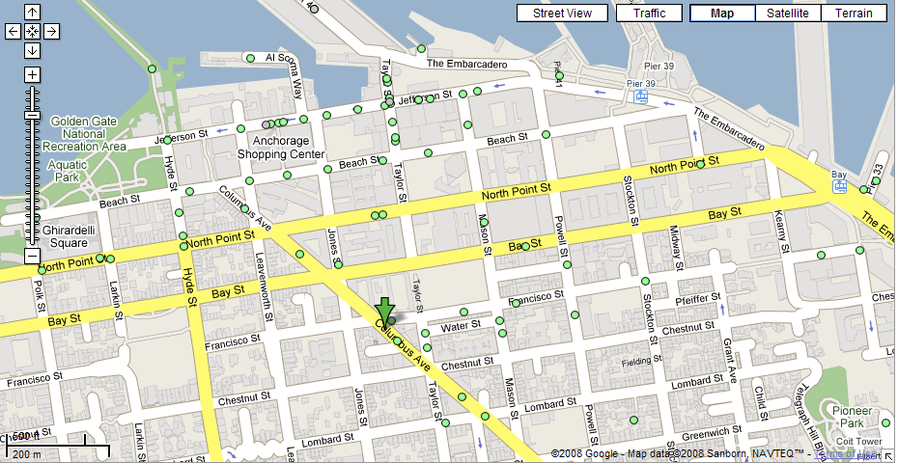
Nearest Neighbor(s) Query
What is the closest restaurant to my hotel?

Slide 9
Nearest Neighbor(s) Query (cont’d)
Find the 4 closest restaurants to my hotel

Slide 10
Multi-dimensional Query
In practice, queries might involve multi-dimensional keys.
key=(Name, Age): retrieve all records with
Name=“George” and “50 <= Age <= 70”
ID Name Age Salary #Children

Slide 11
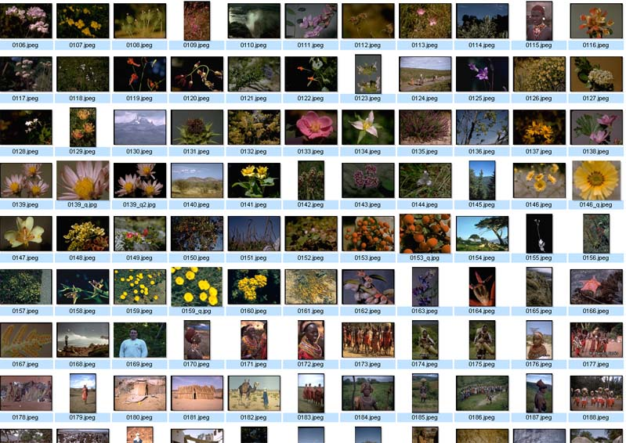
Nearest Neighbor Query in High Dimensions
Very important and practical problem!
Image retrieval
find N closest
matches (i.e., N
nearest neighbors)
(f₁,f₂, .., f_{k})

Slide 12
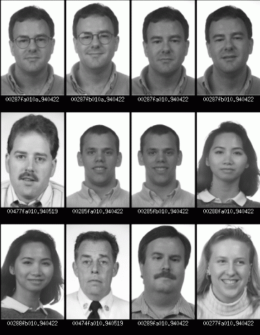
Nearest Neighbor Query in High Dimensions
Face recognition
find closest match
(i.e., nearest neighbor)

Slide 13
We will discuss …
Range trees
KD-trees
Quadtrees

Slide 14
主要内容
Type of Queries
Range Tree
K-D Tree
Quad Trees
1D range search
2D range search
K-D tree construction
K-D tree exact search
K-D tree range search
nearest neighbor search
Hierarchical clustering tree

Slide 15
Interpreting Queries Geometrically
Multi-dimensional keys can be thought as “points” in high dimensional spaces.
Queries about records → Queries about points

Slide 16
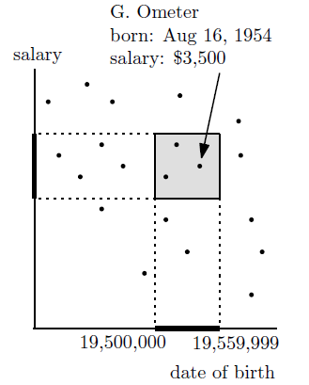
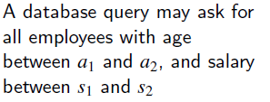
Example 1- Range Search in 2D
age = 10,000 x year + 100 x month + day

Slide 17
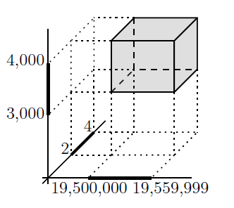
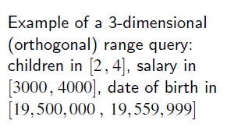
Example 2 – Range Search in 3D

Slide 18
Example 3 – Nearest Neighbors Search
QueryPoint

Slide 19
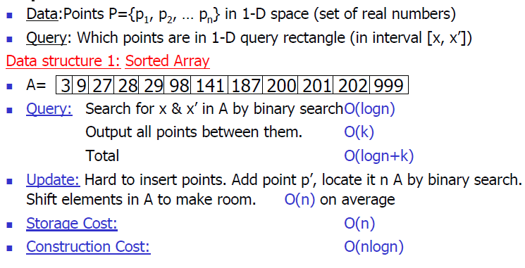
1D Range Search
Data Structure 1: Sorted Array
Data Structure 2: BST
Data Structure 3: BST with data stored in leaves

Slide 20
1D Range Search
Range: [x, x’]
Data Structure 1: Sorted Array
Does not generalize well to high dimensions.
Example: retrieve all points in [25, 90]

Slide 21
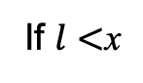
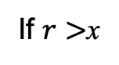
1D Range Search
Data Structure 2: BST
Search using binary search property.
Some subtrees are eliminated during search.
Search using:
Range: [l,r]
Prepare an array to save result.
Recursively search on the tree
private void rsearch(TreeNode root, int l, int r) {
if (root == null) {
return;
}
if (root.val > l) {
rsearch(root.left, l, r);
}
if (root.val >= l && root.val <= r) {
results.add(root.val);
}
if (root.val < r) {
rsearch(root.right, l, r);
}
l,r
x
If $l<$x
If $r>$x
Search left
Search right
x
x
Otherwise add x into results

Slide 22
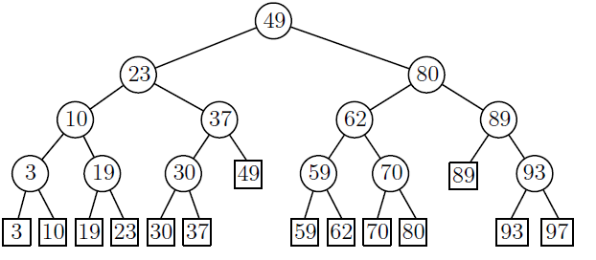
1D Range Search
Data Structure 2: BST
[25, 90]
[25, 90]
[25, 90]
[25, 90]
[25, 90]
[25, 90]
[25, 90]
[25, 90]
[25, 90]
Example: retrieve all points in [25, 90]
Results
30
37
49
59
62
70
80
89
The time complexity is O(logn + k), where k is the number in the range.

Slide 23
1D Range Search
Data Structure 3: BST with data stored in leaves
Internal nodes store splitting values (i.e., not necessarily same as data).
Data points are stored in the leaf nodes.

Slide 24
BST with data stored in leaves
Data Structure 3: BST with data stored in leaves
0
100
25
50
75
50
Data: 10, 39, 55, 120
25
75
10
39
55
120

Slide 25
1D Range Search
Data Structure 3: BST with data stored in leaves
Retrieving data in [x, x’]
Perform binary search twice, once using x and the other using x’
Suppose binary search ends at leaves l and l’
The points in [x, x’] are the ones stored between l and l’ plus, possibly, the points stored in l and l’

Slide 26
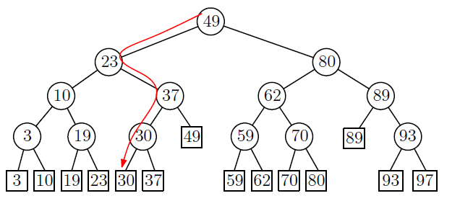
1D Range Search
Data Structure 3: BST with data stored in leaves
Example: retrieve all points in [25, 90]
The search path for 25 is:

Slide 27
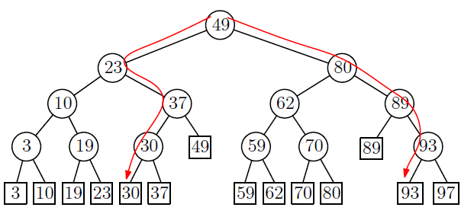
1D Range Search
Data Structure 3: BST with data stored in leaves
The search for 90 is:

Slide 28
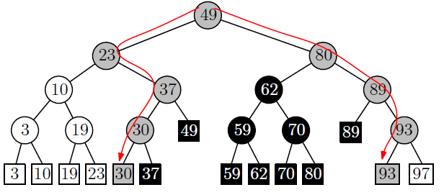
1D Range Search
Data Structure 3: BST with data stored in leaves
Examine the leaves in the sub-trees between the two traversing paths from the root.
split node
retrieve all points in [25, 90]

Slide 29
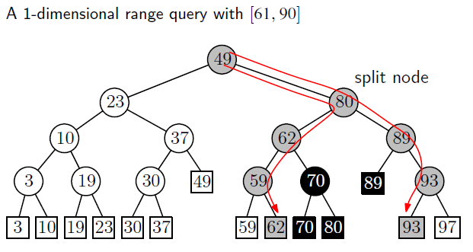
1D Range Search – Another Example
Data Structure 3: BST with data stored in leaves

Slide 30
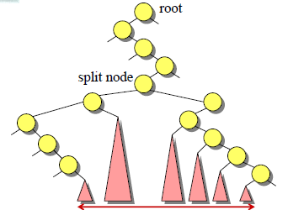
1D Range Search
Data Structure 3: BST with data stored in leaves
How do we find the leaves of interest?
Find split node (i.e., node where the
paths to x and x’ split).
Left turn on left side: report leaves in right subtrees
Right turn on right side: report leaves in left substrees
Right turn on left side or right turn on left side, continue.
O(logn + k) time where k is the number of items reported.

Slide 31
1D Range Search
Data Structure 3: BST with data stored in leaves
Speed-up search by keeping the leaves in sorted order using a linked-list.

Slide 32
1D Range Search: 总结
Data Structure 1: Sorted Array
O(logn + k)
Data Structure 2: BST
O(logn + k)
Data Structure 3: BST with data stored in leaves
O(logn + k)

Slide 33
主要内容
Type of Queries
Range Tree
K-D Tree
Quad Trees
1D range search
2D range search
K-D tree construction
K-D tree exact search
K-D tree range search
nearest neighbor search
Hierarchical clustering tree

Slide 34
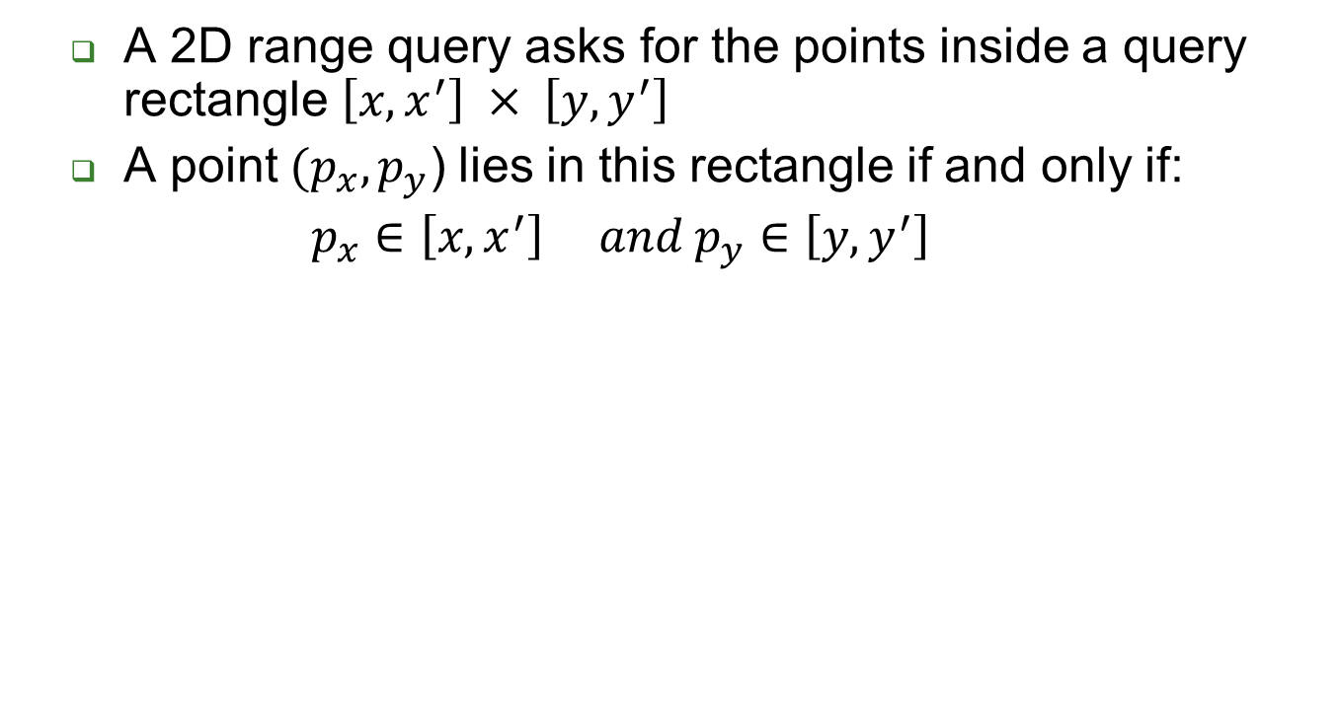
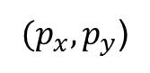

2D Range Search
y’
y

Slide 35
2D Range Search (cont’d)
A 2D range query can be decomposed in two 1D range queries:
One on the x-coordinate of the points.
The other on the y-coordinates of the points.
y’
y

Slide 36
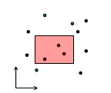
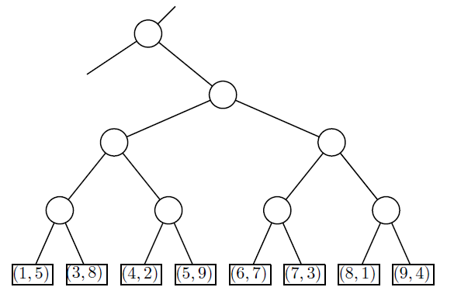
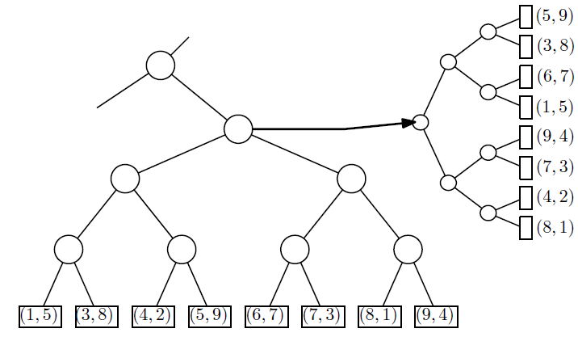
2D Range Search (cont’d)
Store a primary 1D range tree for all the points based on x-coordinate.
For each node, store a secondary 1D range tree based on y-coordinate.
36

Slide 37
Range Tree

Slide 38
2D Range Tree

Slide 39
2D Range Tree

Slide 40
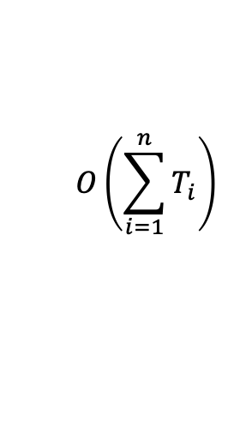
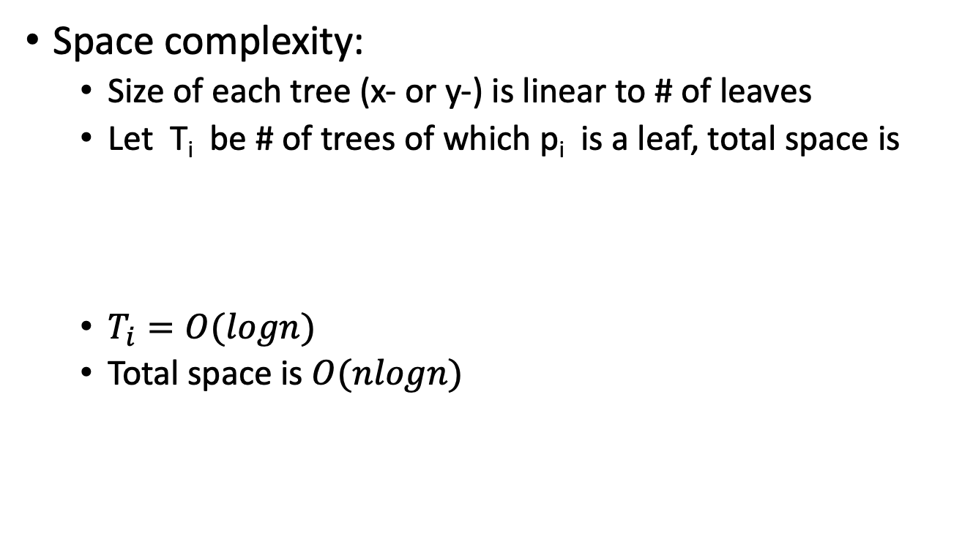
2D Range Tree
Space complexity:
Size of each tree (x- or y-) is linear to # of leaves
Let T_{i} be # of trees of which p_{i} is a leaf, total space is
$T_{i}=O(logn)$
Total space is $O(nlogn)$
$$O\left(\sum_{i=1}^{n}{T_{i}}\right)$$

Slide 41
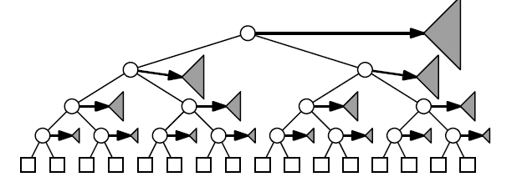
2D Range Tree
Range Tree
Space requirements: O(nlogn)
41

Slide 42
2D Range Tree

Slide 43
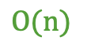

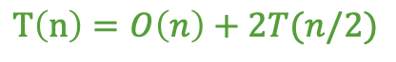
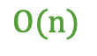
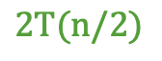
How to build a 2D range tree
$$O(n)$$
$$T\left(n\right)=O\left(n\right)+2T(n/2)$$
$$2T(n/2)$$
$$Construction complexity:$$
$$O\left(nlogn\right)$$
$$O(n)$$

Slide 44
How to build a 2D range tree
Space complexity: O(nLogn)
Building time: O(nLogn)

Slide 45
Range Query in 2D range tree

Slide 46
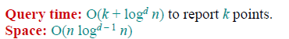
Range Search in d dimensions
1D query time:
O(logn + k)
2D query time:
O(log²n + k)
d dimensions:
46

Slide 47

K-D Trees

Slide 48
主要内容
Type of Queries
Range Tree
K-D Tree
Quad Trees
1D range search
2D range search
K-D tree construction
K-D tree exact search
K-D tree range search
nearest neighbor search
Hierarchical clustering tree

Slide 49
KD Tree
A binary search tree where every node is a
k-dimensional point.
Example: k=2
53, 14
27, 28
65, 51
Split by x-
30, 11
31, 85
70, 3
99, 90
Split by y-
40, 26
7, 39
32, 29
82, 64
Split by x-
29, 16
38, 23
55,62
73, 75
Split by y-
15, 61

Slide 50
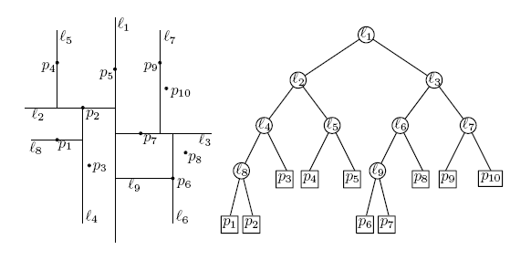
KD Tree (cont’d)
Example: data stored at the leaves

Slide 51
KD Tree (cont’d)
Every node (except leaves) represents a hyperplane that divides the space into two parts.
Points to the left (right) of this hyperplane represent the left (right) sub-tree of that node.
P_{left}
P_{right}

Slide 52
KD Tree (cont’d)
As we move down the tree, we divide the space along alternating (but not always) axis-aligned hyperplanes:
Split by x-coordinate: split by a vertical line that has (ideally) half the points left or on, and half right.
Split by y-coordinate: split by a horizontal line that has (ideally) half the points below or on and half above.

Slide 53
KD Tree - Example
Split by x-coordinate: split by a vertical line that has approximately half the points left or on, and half right.
x

Slide 54
KD Tree - Example
Split by y-coordinate: split by a horizontal line that has half the points below or on and half above.
x
y
y

Slide 55
KD Tree - Example
Split by x-coordinate: split by a vertical line that has half the points left or on, and half right.
x
y
y
x
x
x
x

Slide 56
KD Tree - Example
Split by y-coordinate: split by a horizontal line that has half the points below or on and half above.
x
y
y
x
x
x
x
y
y

Slide 57
Node Structure
A KD-tree node has 5 fields
Splitting axis
Splitting value
Data
Left pointer
Right pointer

Slide 58
Splitting Strategies
Divide based on order of point insertion
Assumes that points are given one at a time.
Divide by finding median
Assumes all the points are available ahead of time.
Divide perpendicular to the axis with widest spread
Split axes might not alternate
… and more!

Slide 59
Example – using order of point insertion (data stored at nodes
Insertion Order: (3, 6), (17, 15), (13, 15), (6, 12), (9, 1), (2, 7), (10, 19)
Node *insertRec(Node *root, int point[], unsigned depth)
{
if (root == NULL)
return newNode(point);
// 确定比较的维度
unsigned cd = depth % k;
// 与root的 cd 维数据进行对比
if (point[cd] < (root->point[cd]))
root->left =insertRec(root->left, point, depth + 1);
else
root->right =insertRec(root->right, point, depth + 1);
return root;
}
(3, 6)
X
(2, 7)
(17, 15)
Y
(6, 12)
(13, 15)
X
(9, 1)
(10, 19)
Y
Node* insert(Node *root, int point[])
{
return insertRec(root, point, 0);
}

Slide 60
Example – using order of point insertion (data stored at nodes)
Like a BST, we would expect insert to take O(logn), since we do a path from root to leaf and in a balanced tree the depth is logn, where n is the number of nodes (equivalent to the number of points).
However, there is a clear degenerate case: if each point increases along every dimension, then the tree becomes a line with height O(n). 1+2+···+n = O(n²), so it might take quadratic time to build a kd-tree in the worst case.
In practice, the points are commonly known ahead of time. Can we guarantee an O(n log n) build over n points if we know the n points ahead of time?

Slide 61
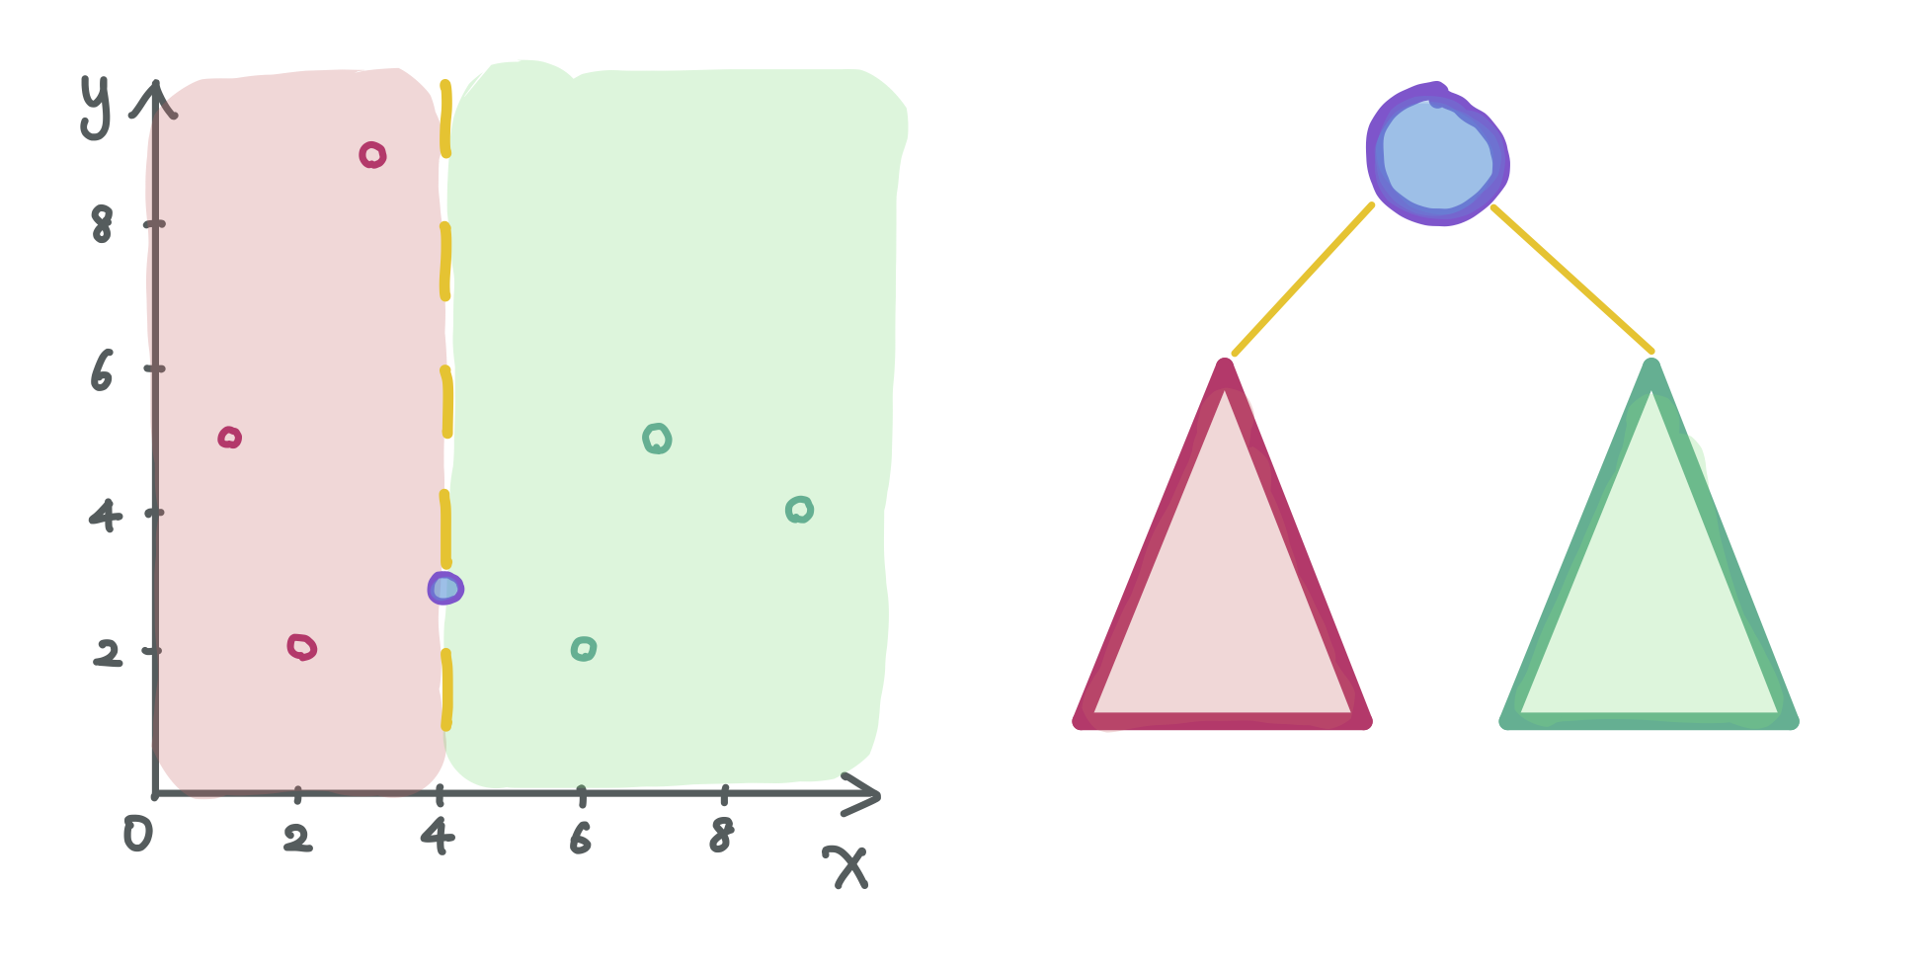
Median-based Construction
The key insight is that splitting the points perfectly in half between the two subtrees is the best possible split. This means we should split based on the median value.

Slide 62
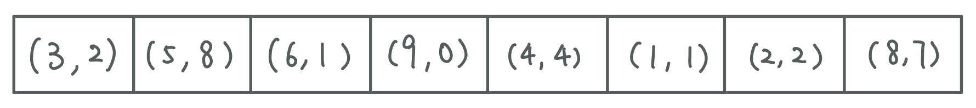
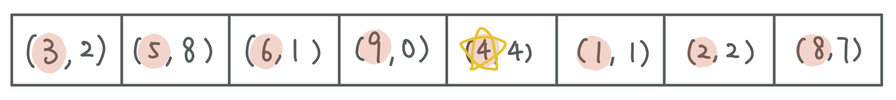
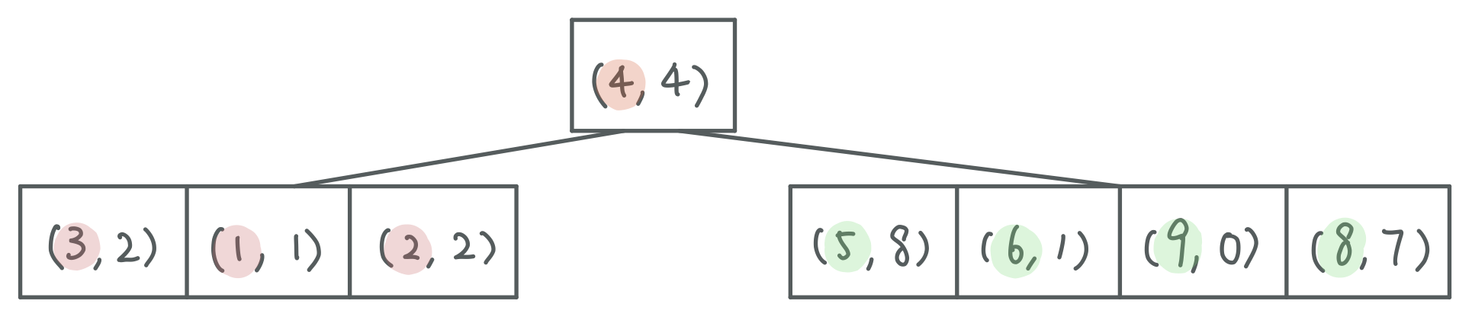
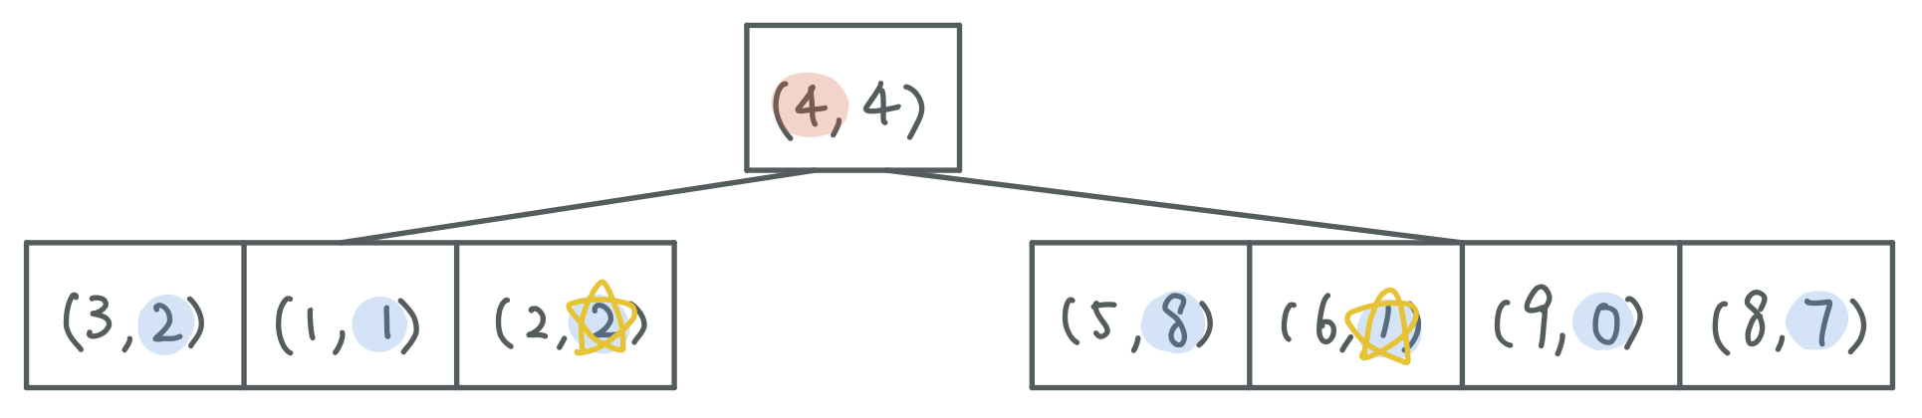

Slide 63
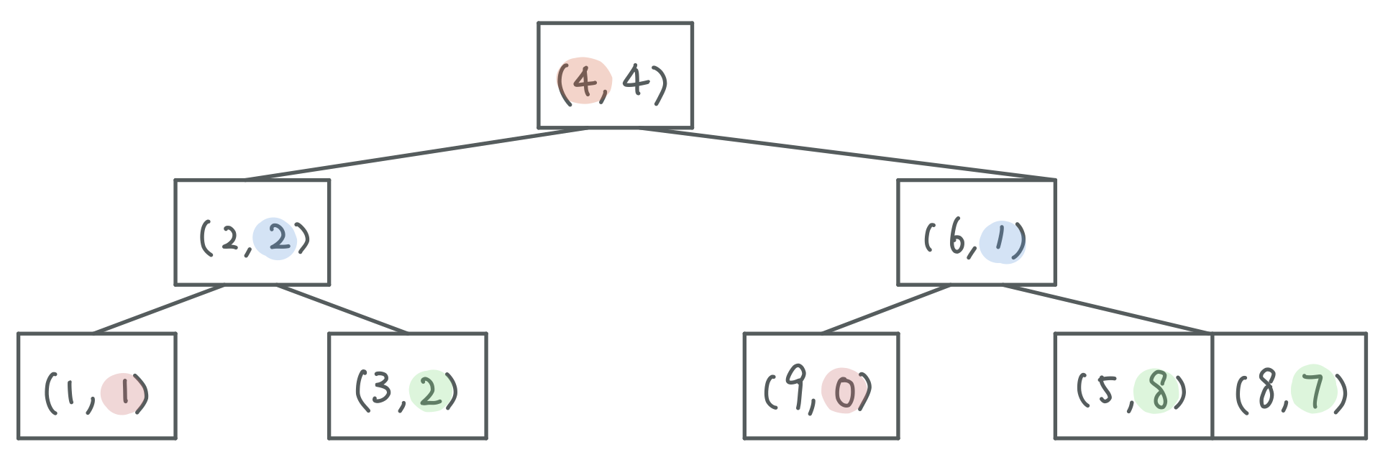

Slide 64
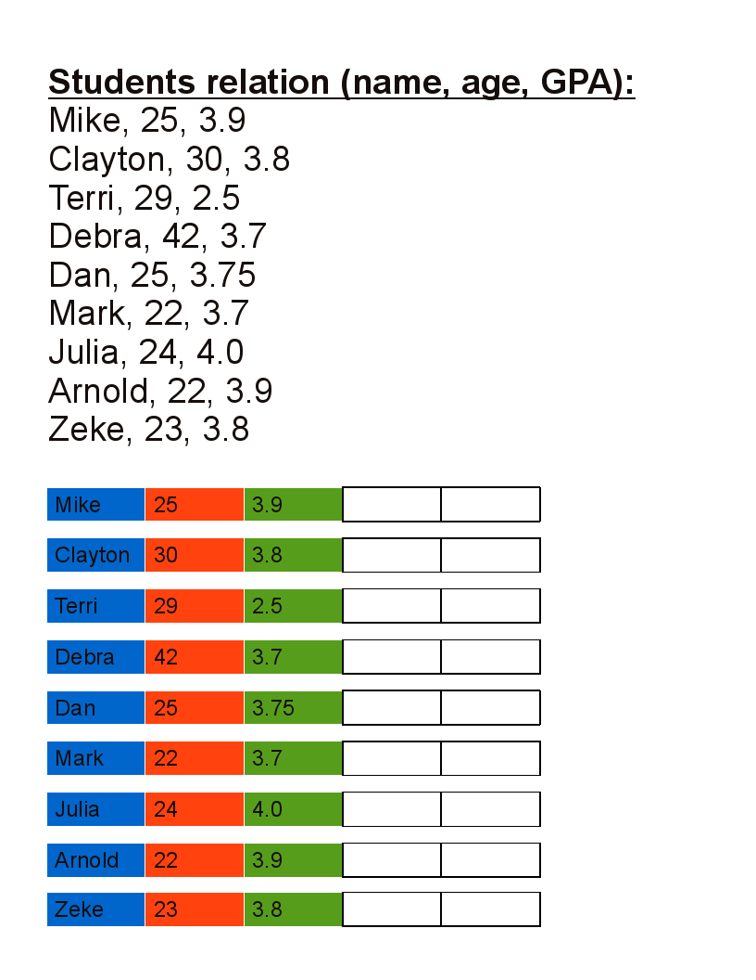
Another Example – using median

Slide 65
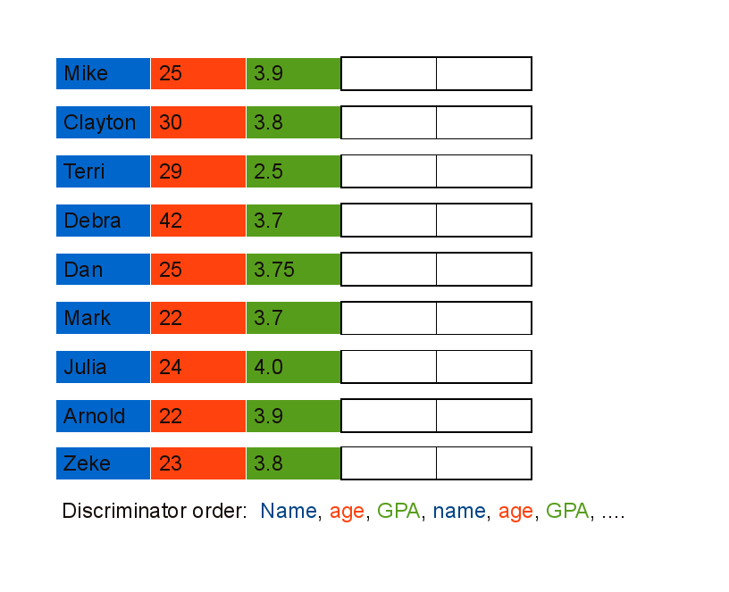
Another Example - using median

Slide 66
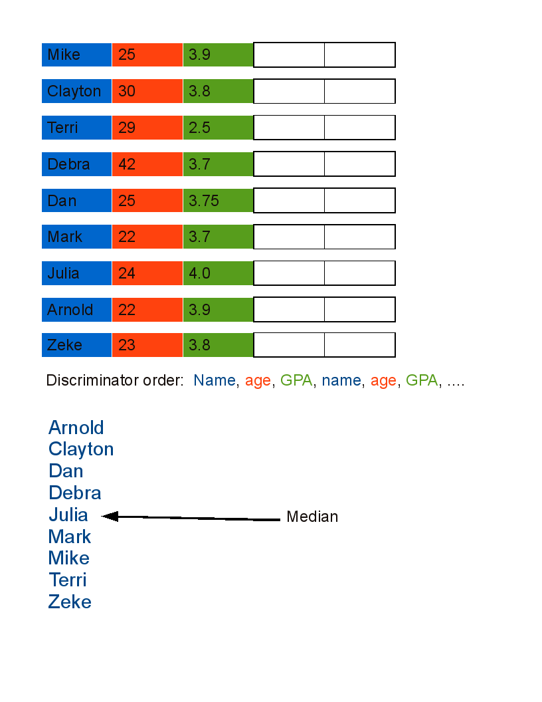
Another Example - using median

Slide 67
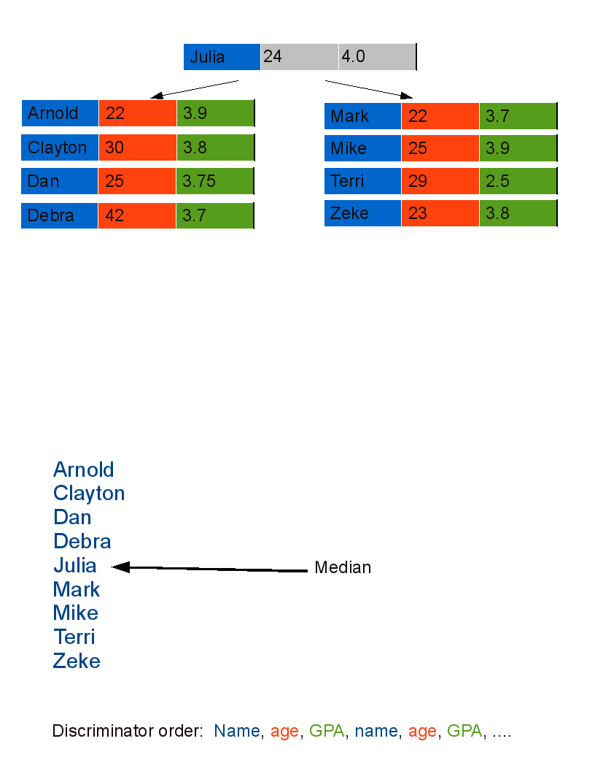
Another Example - using median

Slide 68
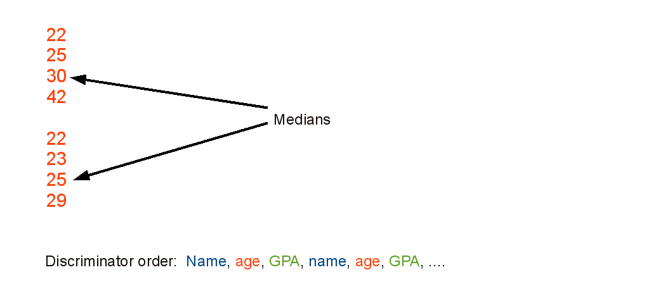
Another Example - using median

Slide 69
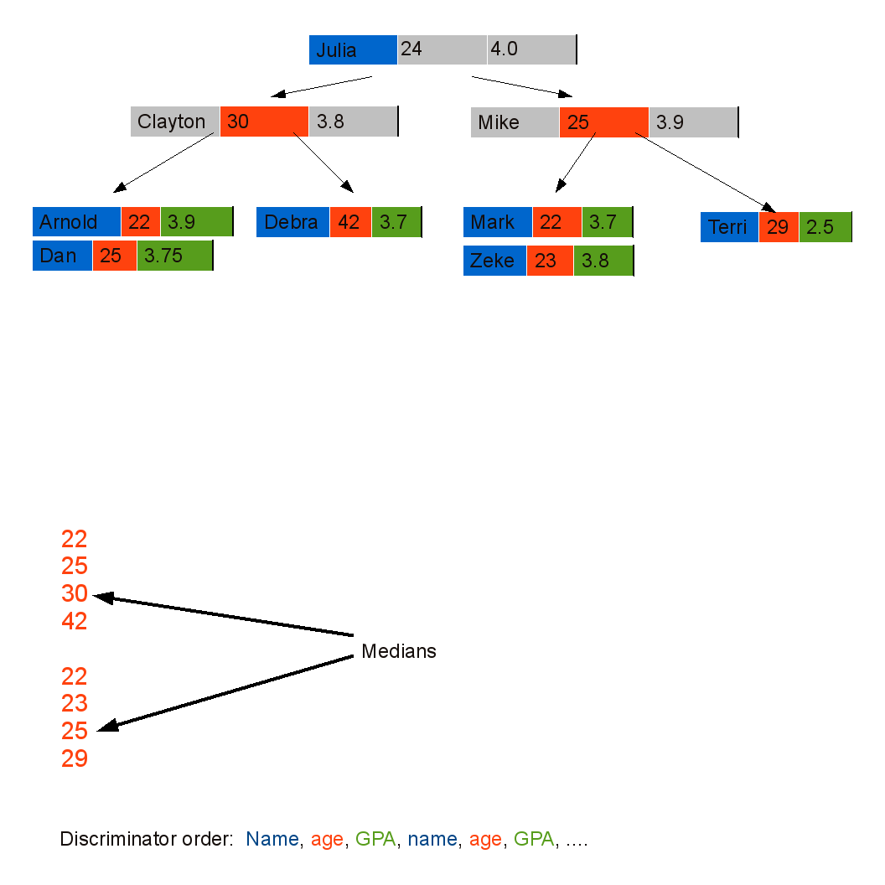
Another Example - using median

Slide 70
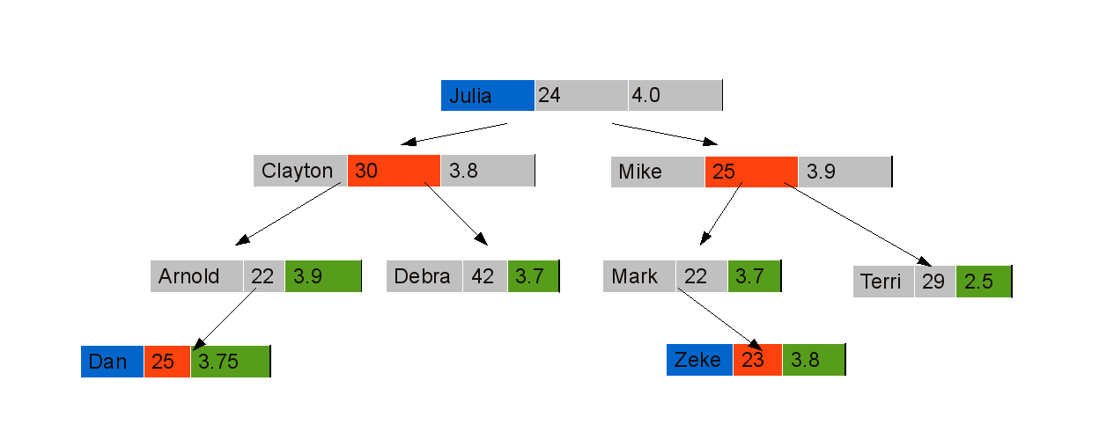
Another Example - using median

Slide 71
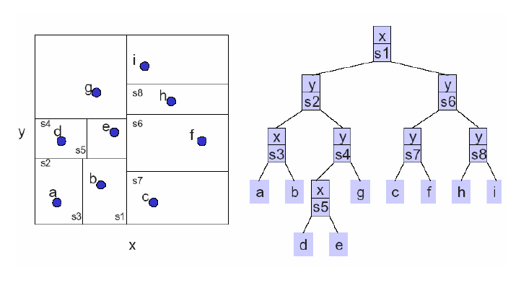
Example – split perpendicular to the axis with widest spread

Slide 72
KD Tree (cont’d)
Let’s discuss
Insert
Delete
Search

Slide 73
Insert (55, 62)
Insert new data
55 > 53, move right
53, 14
x
62 > 51, move right
27, 28
65, 51
y
70, 3
99, 90
x
30, 11
31, 85
55 < 99, move left
29, 16
40, 26
7, 39
32, 29
82, 64
y
38, 23
55,62
73, 75
15, 61
62 < 64, move left
Null pointer, attach
Notes:
73

Slide 74
Delete data
1) If current node contains the point to be deleted
If it is a leaf node, simply delete it (Same as BST Delete)
If it has right child (Different from BST)
在右侧子树中查找当前节点维度的最小值。
用找到的最小值替换节点。
Else If it has left child (Different from BST)
在左侧子树中查找当前节点维度的最小值。
用找到的最小值替换节点，并递归地删除左子树中的最小值。
将新的左子树作为当前节点的右子树。
2) If current is not the point to be deleted
If node to be deleted is smaller than current node on current dimension, recur for left subtree.
Else recur for right subtree.

Slide 75
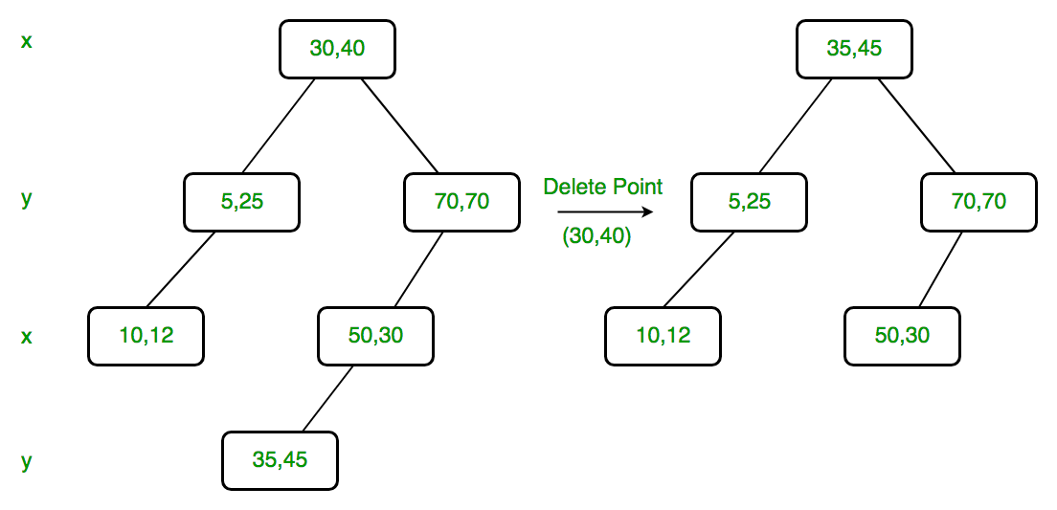
K-D Tree Deletion
Since right child is not NULL and dimension of node is x, we find the node with the minimum x value in the right child.
we replace (30, 40) with (35, 45) and delete (30, 40).

Slide 76
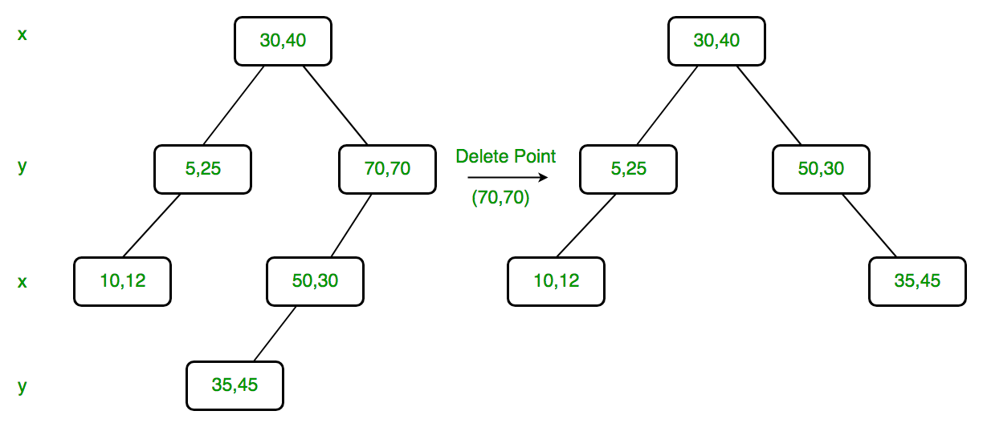
K-D Tree Deletion
Delete (70, 70)
we replace (70, 70) with (50, 30)
recursively delete (50, 30) in left subtree.
Finally we make the modified left subtree as right subtree of (50, 30).
Dimension of node is y. Since right child is NULL, we find the node with minimum y value in left child.

Slide 77
Node *deleteNodeRec(Node *root, int point[], int depth)
{
// Given point is not present
if (root == NULL)
return NULL;
// Find dimension of current node
int cd = depth % k;
// If the point to be deleted is present at root
if (arePointsSame(root->point, point))
{
// 2.b) If right child is not NULL
if (root->right != NULL)
{
// Find minimum of root's dimension in right subtree
Node *min = findMin(root->right, cd);
// Copy the minimum to root
copyPoint(root->point, min->point);
// Recursively delete the minimum
root->right = deleteNodeRec(root->right, min->point, depth+1);
}
else if (root->left != NULL) // same as above
{
Node *min = findMin(root->left, cd);
copyPoint(root->point, min->point);
root->right = deleteNodeRec(root->left, min->point, depth+1);
}
else // If node to be deleted is leaf node
{
delete root;
return NULL;
}
return root;
}

Slide 78

Search in K-D Tree
Exact Search
Range Search

Slide 79
主要内容
Type of Queries
Range Tree
K-D Tree
Quad Trees
1D range search
2D range search
K-D tree construction
K-D tree exact search
K-D tree range search
nearest neighbor search
Hierarchical clustering tree

Slide 80
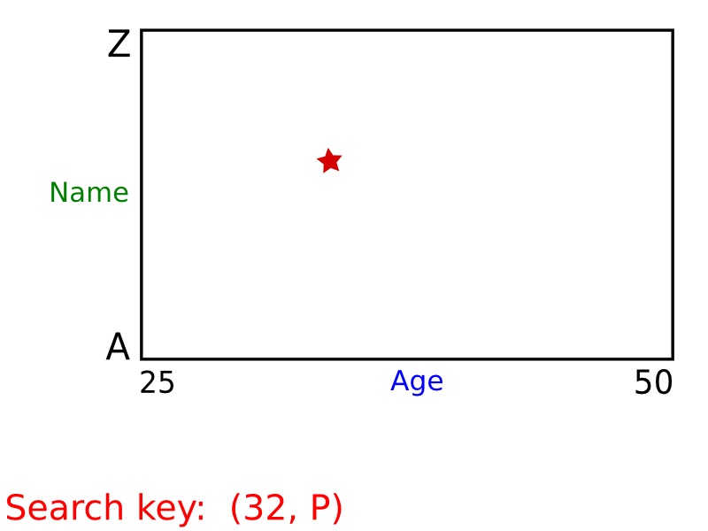
KD Tree – Exact Search

Slide 81
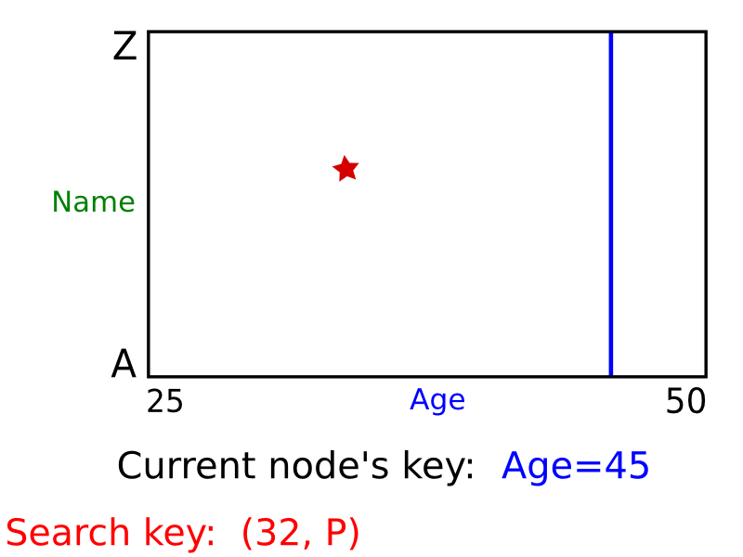
KD Tree – Exact Search

Slide 82
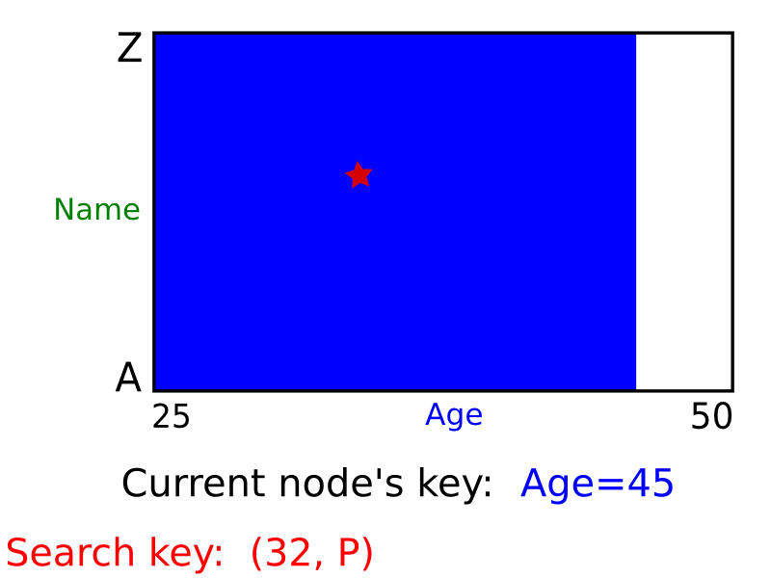
KD Tree – Exact Search

Slide 83
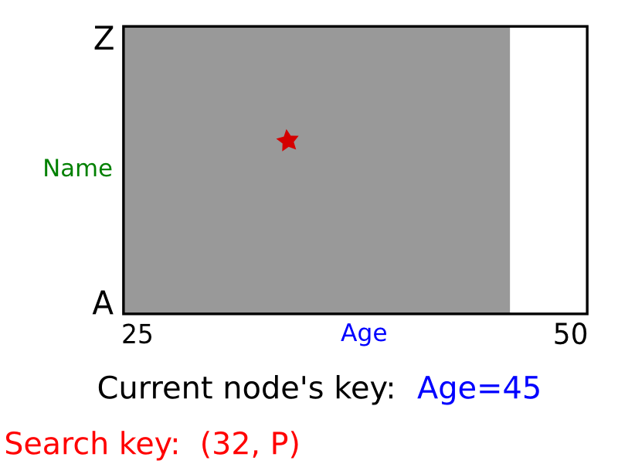
KD Tree – Exact Search

Slide 84

KD Tree – Exact Search

Slide 85

KD Tree – Exact Search

Slide 86

KD Tree – Exact Search

Slide 87

KD Tree – Exact Search

Slide 88

KD Tree – Exact Search

Slide 89

KD Tree – Exact Search

Slide 90

KD Tree – Exact Search
Exact search is just like the sequential insertion process

Slide 91
KD Tree - Range Search
2D Orthogonal Range Query
• Data: A set S of n points
• Query: Report/Count subset of S that lie in a rectangle range

Slide 92
KD Tree - Range Search
We store the data in a KD Tree

Slide 93
KD Tree - Range Search
The range query problem becomes a KD-Tree range query problem.

Slide 94
KD Tree - Range Search
Let’s firstly make clear a concept: Region of a node on KD-tree
The region of a node is the region characterized by the ancestors of the node.
The region of the root node is the full 2D plan because it doesn’t has an ancestor.

Slide 95


Region of a node on KD-Tree
Region(l₂) = the left half plane of Region(l₁)
$$region\left(lc\left(v\right)\right)=region(v)∩{l(v)}^{left}$$
Region(l₃) = the right half plane of Region(l₁)
$$region\left(rc\left(v\right)\right)=region(v)∩{l(v)}^{right}$$

Slide 96
Region of a node on KD-Tree
Region(l₄) = the down half plane of Region(l₂) seperated by l₂
Region(l₅) = the up half plane of Region(l₂) seperated by l₂
How to represent and how to record region for a node?

Slide 97
KD-Tree Node data structure
class Node
{
public:
Node* left; //left child
Node* right; //right child
int begin; //start index [close
int end; //end index (open
Dimension dimension; //cut dimension
double pivot; //cut value
Node(int b, int e, Dimension dim, double piv);
bool IsLeaf() const;
BBox LeftSubTreeEnvelope(const BBox& current_entext) const;
BBox RightSubTreeEnvelope(const BBox& current_entext) const;
};

Slide 98
Region of a node on KD-Tree
BBox::BBox(double x0, double x1, double y0, double y1) :
xmin(x0), xmax(x1), ymin(y0), ymax(y1),
{}
某节点的左子树的Region范围
BBox Node::LeftSubTreeEnvelope(const BBox& current_entext) const{
BBox leftRegion(current_entext);
//继承父节点的region
switch (dimension){
case X:
leftRegion.xmax = pivot;
//x方向最大值设为此节点x值
break;
case Y:
leftRegion.ymax = pivot;
//y方向最大值设为此节点y值
break;
}
return leftRegion;
}

Slide 99
Region of a node on KD-Tree
BBox Node::RightSubTreeEnvelope(const BBox& current_entext) const
{
BBox rightRegion(current_entext);
switch (dimension)
{
case X:
rightRegion.xmin = pivot;
//修改x方向最小值
break;
case Y:
rightRegion.ymin = pivot;
// 修改y方向最小值
break;
}
return rightRegion;
}

Slide 100
Region of a node on KD-Tree
这样无需存储，而是可以在线遍历节点的时候，实时计算节点的region

Slide 101
Region Search in a KD-Tree

Slide 102
Region Search in a KD-Tree

Slide 103
Region Search in a KD-Tree

Slide 104
Region Search in a KD-Tree

Slide 105
Region Search in a KD-Tree

Slide 106
Region Search in a KD-Tree

Slide 107
Region Search in a KD-Tree
Range of # lies within the query range. The whole subtree rooted at # is reported.

Slide 108

KD Trees – Range Search
query range
Need only search nodes whose region intersects query region.
Report all points in subtrees whose regions are entirely contained in query range.
If a region is partially contained in the query range then recursively query the subtrees.

Slide 109

Example – Range Search
All other nodes visited (i.e., gray) correspond to regions
that are only partially inside the query rectangle.
- Report points p₆ and p₁₁ only
- Do not report points p₃, p₁₂ and p₁₃

Slide 110
Query a K-d tree
Time complexity analysis
Query(t,r) is called if t’s parent’s region intersects (but does not lie inside) r
Such region must contain a border edge of r

Slide 111
Time complexity of Range Search in K-D Tree
How many nodes of a k-d tree can be “stabbed”(刺穿) by a line (i.e., the line passes through the node’s region)?

Slide 112
Time complexity of Range Search in K-D Tree

Slide 113
Time complexity of Range Search in K-D Tree

Slide 114
Time complexity of Range Search in K-D Tree

Slide 115

Time complexity of Range Search in K-D Tree
log(n)
$2^{\frac{logn}{2}}$=$\sqrt{n}$

Slide 116
Time complexity of Range Search in K-D Tree

Slide 117
Time complexity of Range Search in K-D Tree
Suppose there are k nodes in the range

Slide 118
总结：KD Tree (vs Range tree) in d-dimensions
Construction→ O(dnlogn)
Sort points in each dimension: O(dnlogn)
Determine splitting line (median finding): O(dn)
Space requirements:
KD tree: O(n)
Range tree: O(nlog^{d-1}n)
Query requirements:
KD tree: O(n^{1-1/d}+k)
Range tree: O(log^{d}n+k)
O(n+k) as d increases!
Notes:
118

